Slide 1

MINI PROJECT EC 281 DEVELOPMENT OF DIGITAL CAR WITH ENHANCED SECURITY AND AUTOMATION FEATURES
.
UNDER THE GUIDANCE OF DR. SHIKHA BAGHEL
SAIRAM WANI 221EC245
PALLAVI PARAGE 221EC234

Slide 2
INTRODUCTION TO PROBLEM STATEMENT
Hacking: Malicious actors could gain unauthorized access to the car by exploiting vulnerabilities in the software or hardware.
Signal Jamming: Jamming the unlocking signal could prevent authorized users from accessing the car.
Hardware failure: Faulty components could prevent the system from functioning properly.
Software glitches: Bugs in the software could lead to unintended behavior, such as accidental locking or unlocking.
Manual gear transmission systems have become outdated now, as automatic transmission is excessively used and the first choice for first time car drivers. In modern gearboxes, the transmission module controls the pressure and the switching times based on a number of sensors (of the motor and transmission). The full process of opening the clutch, switching to a new gear, and closing the clutch is electronically controlled.

Slide 3
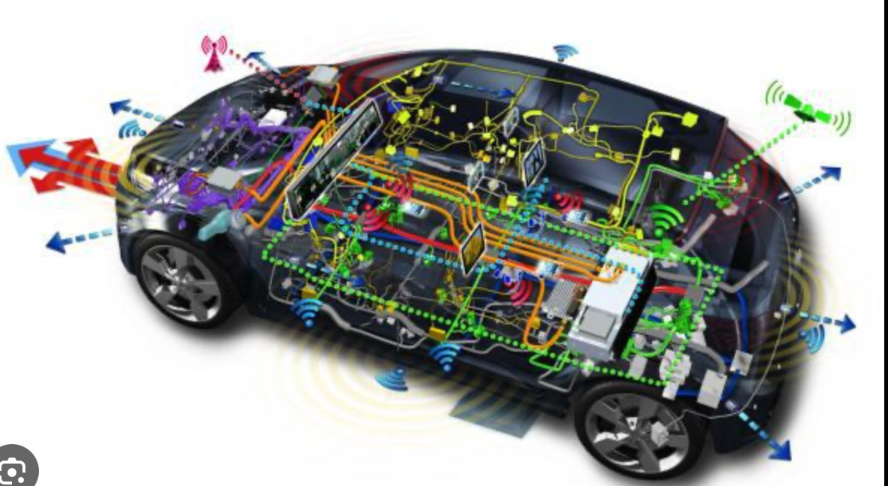
MOTIVATION
Automatic gear systems can help minimize the risk of driver error associated with gear shifting, potentially leading to fewer accidents.
Automatic headlights activated by light sensors can ensure optimal visibility during low-light conditions, reducing the risk of nighttime accidents.
Light sensors eliminate the need for drivers to manually turn headlights on/off, enhancing convenience and safety.
Digital lock systems provide a convenient and secure way to enter and exit the vehicle without needing a physical key.

Slide 4
LITERATURE REVIEW
Security and Hacking: Studies by [Liu et al., 2021] and [Rad et al., 2020] highlight the increasing concerns over hacking vulnerabilities in digital lock systems. They explore common methods like relay attacks and emphasize the need for robust security measures like multi-factor authentication and encryption.
The study by [Sivaramanet al., 2017] examines the use of smartphone apps as digital keys. They highlight the benefits of convenience and remote access control while acknowledging potential security concerns and the need for secure communication protocols.
[Wang et al., 2019] investigates the impact of environmental factors like dust and moisture on light sensor performance. They propose self-cleaning mechanisms and improved sensor housing designs to mitigate these issues.
The research by [Ibrahimy et al., 2020] examines existing and evolving regulations regarding car safety features and the potential legal considerations of implementing advanced digital technologies. Staying updated on these regulations is crucial for ensuring car manufacturers comply with legal requirements.

Slide 5
Industry reports by [McKinsey & Company, 2023] and [Deloitte, 2022] discuss the future of digital cars, highlighting trends like autonomous driving, vehicle connectivity, and the potential impact on car design and functionality. Understanding these trends can inform the development and implementation of future digital features in cars.
Research by [Ma et al., 2018] investigates the use of fingerprint recognition for car access, finding it to be a secure and convenient alternative to traditional keys. Similarly, [Akkaya et al., 2019] explores facial recognition for car unlocking, emphasizing the importance of user privacy and data security considerations.
[Hu et al., 2019] discusses how data from light sensors can be integrated with ADAS features like automatic high beams and lane departure warnings. This integration can create a more comprehensive safety system by adjusting vehicle behavior in response to real-time lighting conditions.

Slide 6
PROPOSED OBJECTIVES
Objective 1:
DIGITAL LOCK SYSTEM
Design and implement a robust digital lock system to replace conventional key-based entry mechanisms.
Objective 2:
SPEED LIMIT ALARM FOR GEAR SYSTEM
Develop a speed-limit alarm integrated into the car's gear system to alert the driver when the vehicle exceeds a predefined speed threshold..
Objective 3:
HEADLIGHTS WITH LIGHT SENSOR
Engineer a lighting system for the car's headlights that automatically adjusts brightness in response to ambient light levels sensed by a light sensor..

Slide 7
Last Week of JAN 2024
Confirmation of Project and zeroth presentation
Last Week of FEB 2024
Design a circuit
Implement the circuit simulation on Logisim
First Week of MARCH 2024
Midsem evaluation and progress seminar
Second Week of MARCH 2024
Begin with the hardware implementation
Final Week of March/Second Week of April 2024
Finish hardware implementation and come up with a working prototype.
Mini project report submission
Endsem evaluation and progress seminar
PROJECT TIMELINE

Slide 8
WORKDONE AND PROGRESS MADE
Our car system has 3 features
1.To simulate a physical 4 digit number lock with the ability to-
Clear the number entered.
Display whether the lock is locked or unlocked.
A counter to count the number of attempts to enter the password and which lights a
LED once the number of 3 failed attempts.
2. A automatic light sensor which switches ON the headlights of the car at night.
3. A automatic gear system-
Ignition = 0, Car will be in OFF position. Thus, SPEED = 0
When A = 1, B = 0: On application of each clock pulse, the SPEED will get incremented by 10 kmph till a maximum limit of 150 kmph.
When A = 0, B = 1: Every clock pulse will decrement the SPEED by 10 kmph

Slide 9
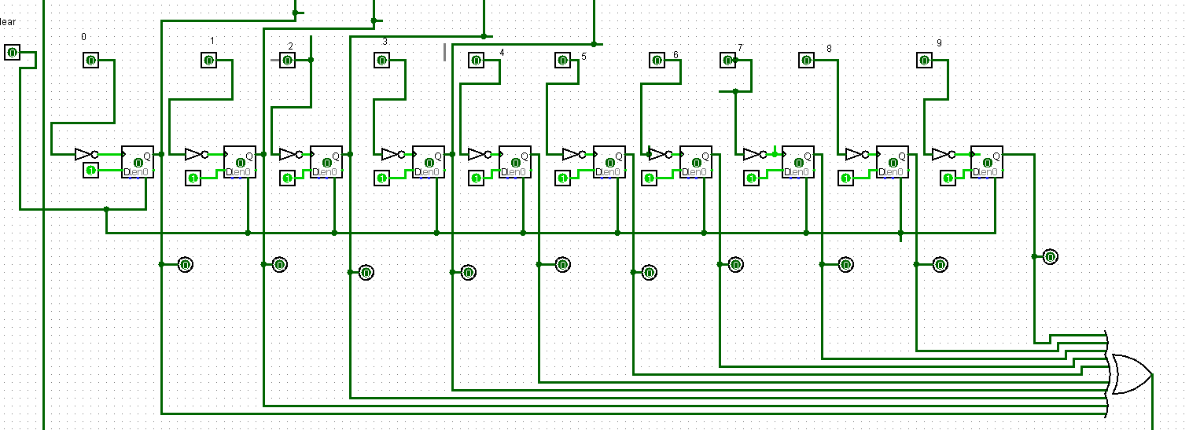
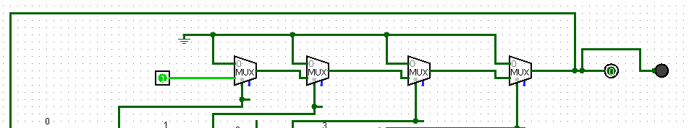
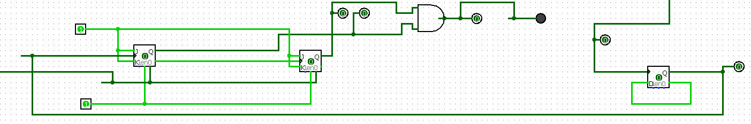
DIGITAL LOCK SYSTEM
Keypad which has a clear option along with the input pins.
When the button in pressed 1 is the input to the circuit. When the button is released 0 is the input to the circuit.
The clock for all sequential circuits are taken from the input of the keypad as we press one key at a time.
A memory element to store the current input and the correct pin.
This circuit checks if the entered password is correct.
The LED glows if the password entered is correct
The counter counts the number of attempts.
LED glows if there are 3 failed attempts.
Count is reset to zero after correct password is entered

Slide 10
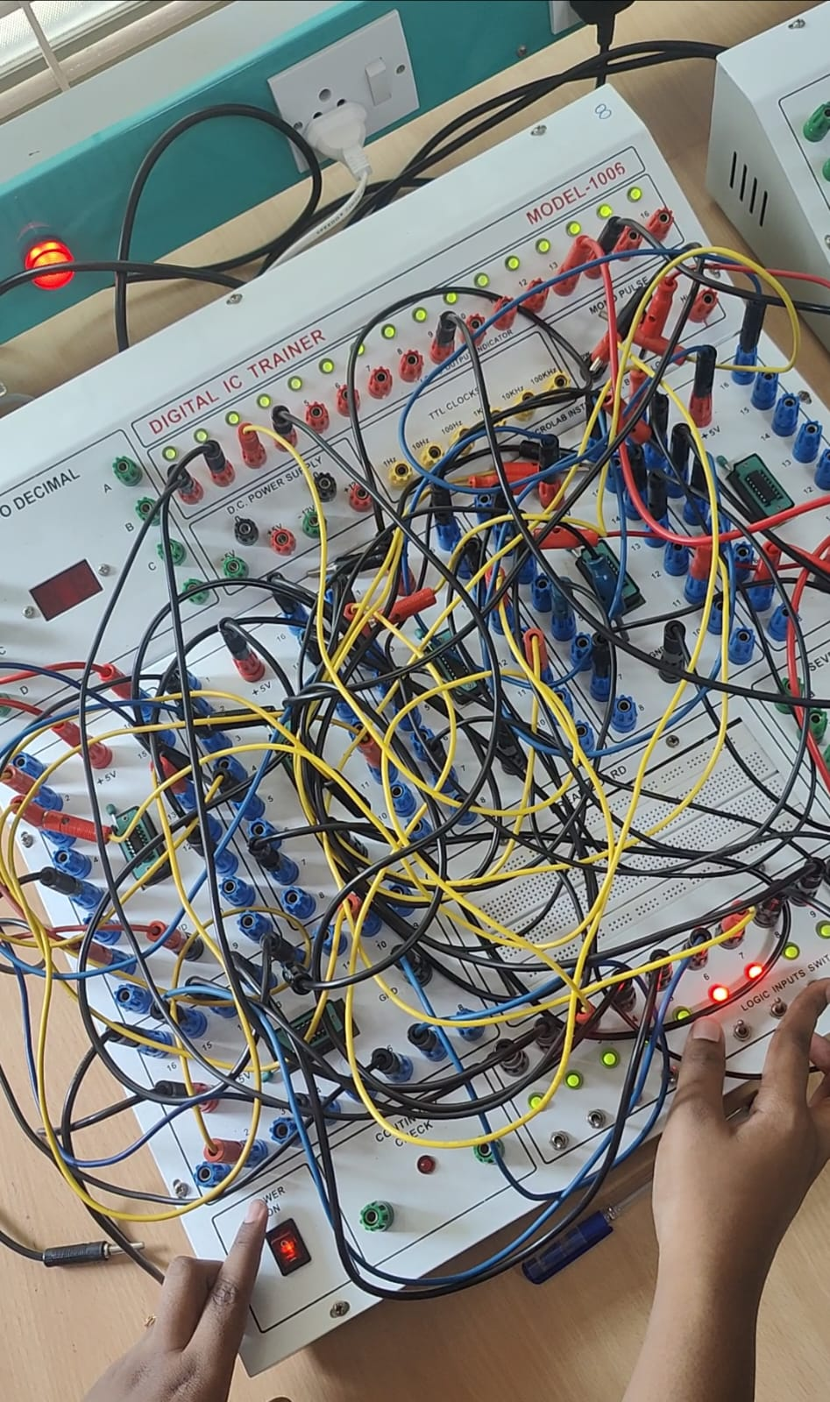
HARDWARE IMPLEMENTATION
Implementation of this circuit on a trainer kit:
Following software simulation, we moved to circuit implementation of the designed software simulation on a trainers’ kit , translating virtual design into physical circuit
Digital%20Lock%20System.mp4

Slide 11
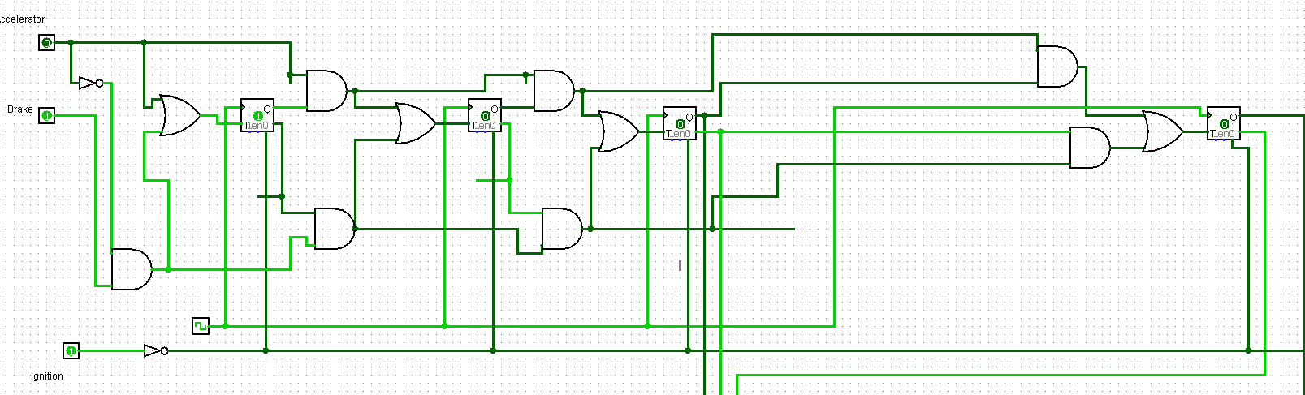
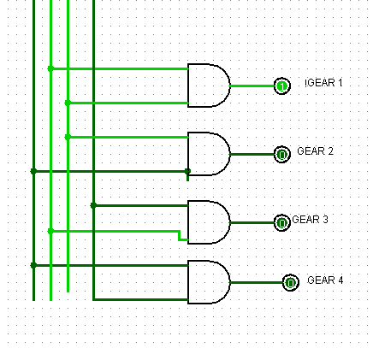
AUTOMATIC GEAR SYSTEM
Counter that detects the increment/decrement of speed by 10km/hr.
Gear system that shows the current gear.
0-30-GEAR 1
40-70-GEAR 2
80-110-GEAR 3
120-150-GEAR 4

Slide 12
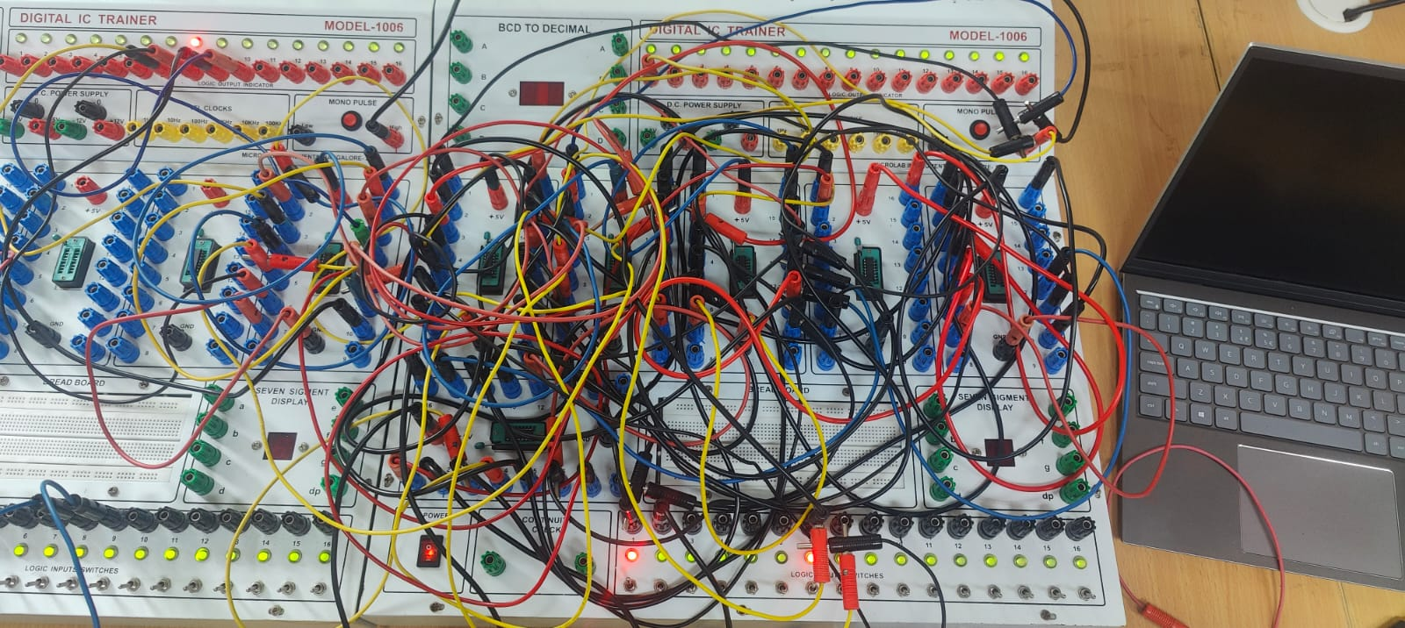
HARDWARE IMPLEMENTATION
Automatic gear system

Slide 13
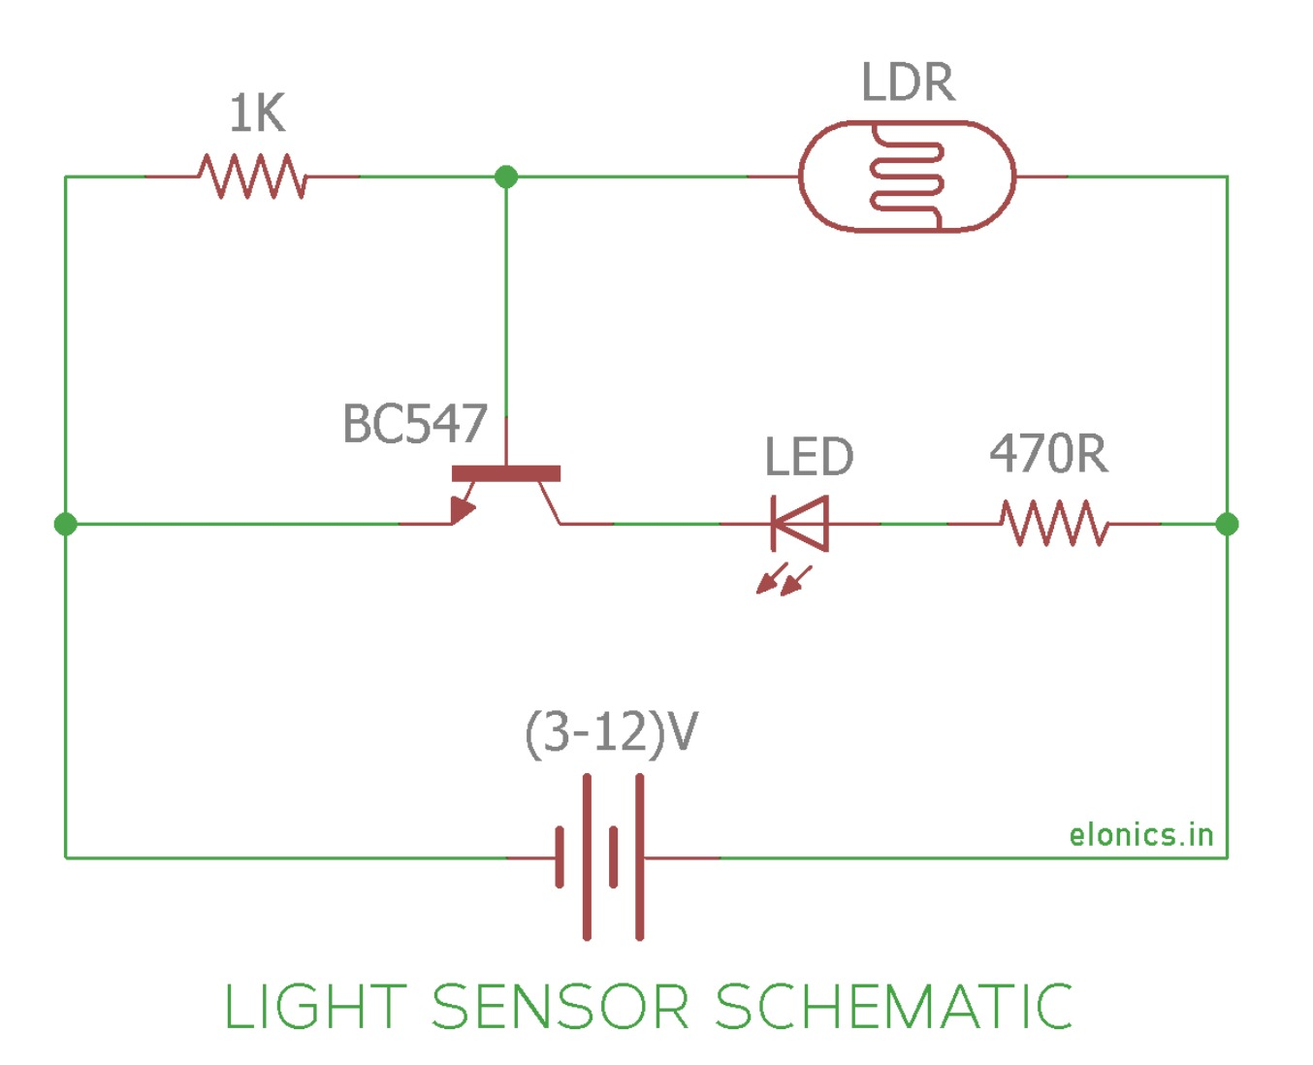
LIGHT SENSOR
Light sensor detector which turns on the headlight of the car during night time automatically

Slide 14
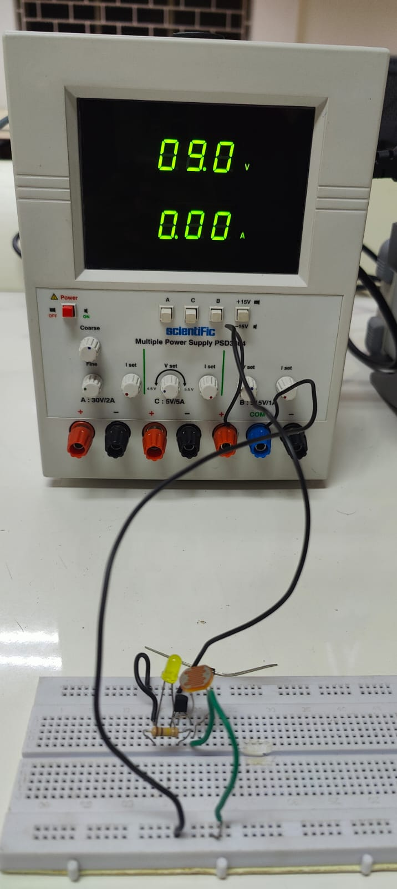
HARDWARE IMPLEMENTATION
Light sensor

Slide 15
CONCLUSION
A Digital Car Ushering in a New Era of Security and Automation
It outlines the intended features of the car, including a digital lock system, automatic gear system, and light sensor.
The development of a digital car with enhanced security and automation features represents a significant step towards a future of safer, more convenient, and technologically advanced transportation.

Slide 16
REFERENCES
Gyanendra K Verma and Pawan Tripathi, “A digital security system
Door lock system using RFID technology”, International Journal of Computer Application,Volume 5–No.11, pp. 6-8, August 2010
Digital System Design and Computer Architecture by David Money Harris and Sarah L. Harris

Slide 17
THANK YOU

